Slide 1

DATABASE SYSTEMS
Week 3

Slide 2

“The goal is to turn data into information and information into insight”
Carly Fiorina –
former CEO HP

Slide 3
DEFINITIONS

Slide 4
DATA & INFORMATION
Raw facts are called “Data”.
“Sara” 27 6
“Zohaib” 34 12
“Processed Data” forms Information.
EMPLOYEE_NAME | AGE | YEARS_OF_EXPER.
Sara | 27 | 6
Zohaib | 34 | 12

Slide 5
DATA & INFORMATION
Steps to Convert Data into Information
Data Collection/ Gathering
Data Storage
Data Manipulation
Data Retrieval

Slide 6
DATABASE
Definition 1:
“Database is a shared collection of logically related data that is stored to meet the requirements of different users of an Organization.”

Slide 7
DATABASE
Definition 2:
“Database is a self-describing collection of integrated records.”

Slide 8
DATABASE
Definition 3: UoD (Universe of Discourse)
A database represents some aspect of the real world, sometimes called the miniworld
or the universe of discourse (UoD). Changes to the miniworld are reflected in the database.

Slide 9
DATABASE MANAGEMENT SYSTEM
Definition 1:
“DBMS is a collection of programs that enables users to create and maintain databases.”

Slide 10
DATABASE MANAGEMENT SYSTEM
Definition 2:
“DBMS is a collection of programs that are used to manage Data in database and the Users of database.”

Slide 11
DATABASE MANAGEMENT SYSTEM
Definition 3:
“DBMS is a general purpose Software System that facilitated the process of defining, constructing, manipulating and sharing DB among different users and applications.”

Slide 12
FILES VS. DATABASES

Slide 13
FILE PROCESSING SYSTEM
Disadvantages
Redundancy-Data Duplication
No Sharing
Inconsistency
Poor Enforcement of Standards
Synonym
Homonym
Excessive Program Maintenance

Slide 14
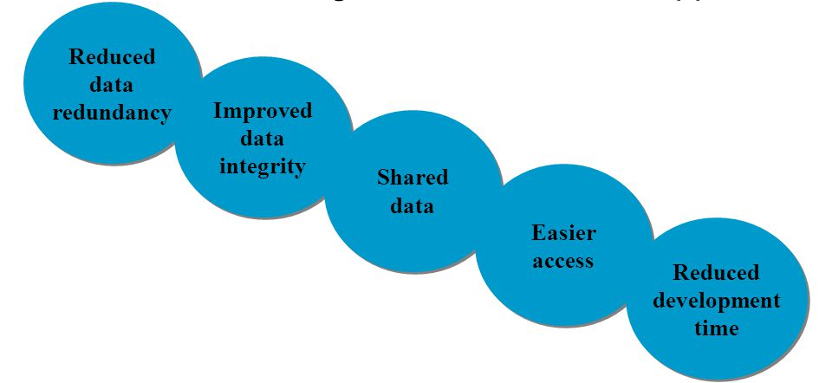
CHARACTERISTICS OF DB APPROACH

Slide 15
SUPPORT OF MULTIPLE DATA VIEWS
View is a subset of Database
View contains virtual Data that is derived from Database file but is not explicitly stored.

Slide 16
DATA SHARING & MULTI-USER TRANSACTION PROCESSING
Query
“Request for information from Database”
Transaction
“An executing program or process that includes one or more DB Access for reading or updating records”

Slide 17
USERS OF DATABASE

Slide 18
DATABASE ADMINISTRATOR (DBA)
“A person who has central control over data and programs that access that data”
Sole Administrator of the two DB environment resources:
Database
DBMS
Technical Person dealing with DB recovery and maintenance etc.

Slide 19
DATABASE ADMINISTRATOR (DBA)
Main Functions of DBA
Data Definitions
Granting Access Authentication Levels
Routine Maintenance
Backups
Maintaining Disk Space
Maintaining Job’s Execution and Response Time

Slide 20
DATABASE DESIGNERS
Identifies the data to be stored in DB
Come-up with appropriate DB structure

Slide 21
END USERS
Casual End-Users
Occasionally access DB maybe each time for different information
Senior or Middle Managers
Naïve or Parametric End-Users
Access only through Application program and “Canned Transactions”

Slide 22
END USERS
Sophisticated Users
Access DB through Application Program and direct access to Data as well
Appropriated Authentication Level is reqd.
Standalone Users
Maintain personal Database for their own use
E.g. a person’s Taxation Data

Slide 23
SYSTEM ANALYST
Determines requirements of End-Users (Naïve & Sophisticated)
Design Canned Transactions

Slide 24
APPLICATION PROGRAMMERS
Implements the Canned Transactions
Also called Software Engineers or Software Developers

Slide 25
TYPES OF DBMS

Slide 26
TYPES OF DBMS
Relational
Data Model is based on tables
Network
Data Model based on graph with nodes as records and relationship between records as edges
Hierarchical
Data Model based on tree data structure

Slide 27
ADVANTAGES OF DBMS APPROACH

Slide 28
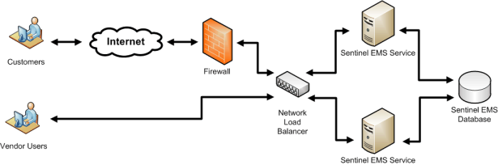
REDUNDANCY
Duplication for availability

Slide 29
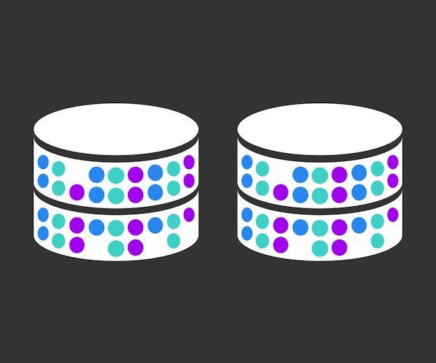
CONTROLLED REDUNDANCY
Redundancy is repetition of Data
Leads to Data Duplication
Loss of Storage Space
Inconsistency of repeated data

Slide 30

DATA SHARING AMONG MULTIPLE USERS

Slide 31
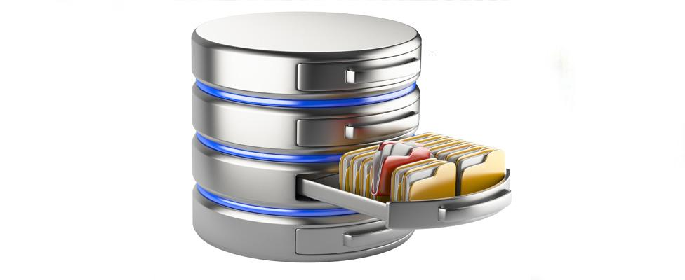
PERSISTENT STORAGE TO PROGRAM OBJECTS
Objects can be stored in DB
Such Objects are persistent as the can be accessed later

Slide 32

STORAGE STRUCTURE FOR EFFICIENT QUERY PROCESSING
DBMS has capabilities for efficient execution of transactions
Specialized data-structures for searching
Auxiliary files called Indexers are used
Indexers use Tree or Hash Data Structure

Slide 33
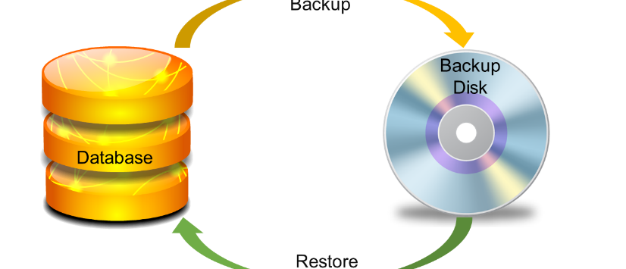
BETTER BACK-UP AND RECOVERY PROCEDURES
Back-up frequency depends upon sensitivity of data

Slide 34

PROVIDING MULTIPLE INTERFACES TO DIFFERENT CLASSES OF USERS

Slide 35
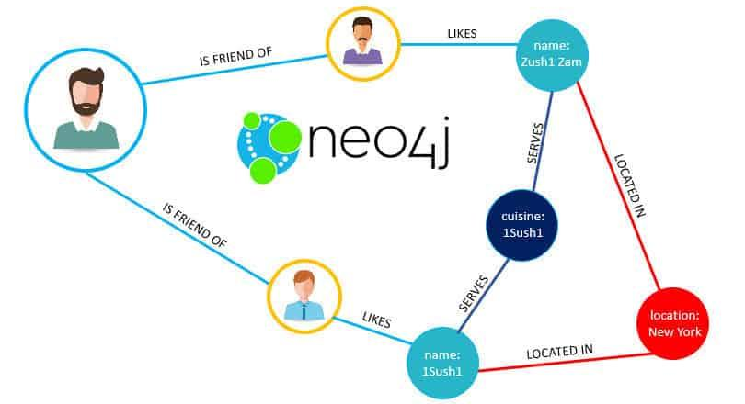
REPRESENTING COMPLEX RELATIONSHIPS IN DATA
Representing Complex Relationships in Data

Slide 36

RESTRICTED UN-AUTHORIZED ACCESS

Slide 37
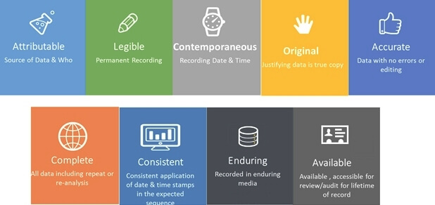
ENFORCING INTEGRITY CONSTRAINTS
Ensuring that data is entered as per data length of field
Field Constraints are not violated
Potential for Enforcing Standards

Slide 38
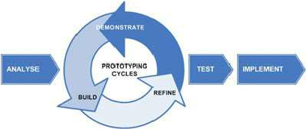
FASTER DEVELOPMENT OF NEW APPLICATIONS
Once DB is up and running very less time is required to align a new Application Program with it Availability of Up-to-date Information

